Slide 1
Popularity Analysis on Spotify

Slide 2
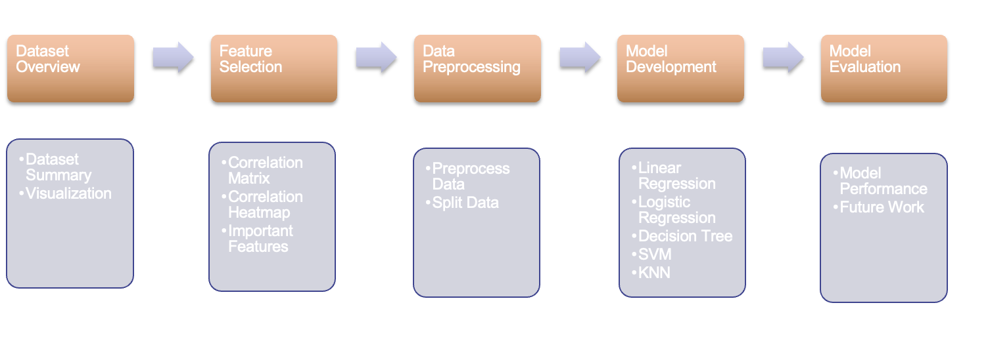
Overview

Slide 3
Data Description
Description: The dataset contains more than 160.000 songs collected from Spotify Web API. The dataset is from Spotify and contains 169k songs from the year 1921 to year 2020. Each row contains all information of a song such as features, name, release year etc.
Number of Records: 169k rows, 19 columns
The period of time: 1921-2020, 100 song each year
The target variable of interest: popularity (ranges from 0-100)
Dataset link : https://www.kaggle.com/datasets/ektanegi/spotifydata-19212020?resource=download

Slide 4
Dataset Overview
Numerical variables:
Acousticness (0-1)
Danceability (0-1)
Energy (0-1)
Duration_ms (0-300k)
Instrumentalness (0-10)
Valence (0-1)
Popularity (0-100)
Tempo (0-245)
Liveness (0-1)
Loudness (-60,0)
Speechiness (0-1)
Year (1921-2020)
Categorical variables:
Key (0-11)
Mode (0-1)
Artist (0-11)
Release_date (yyyy-mm-dd)
Name
Id
Notes:
No duplicates based on id, some outliers

Slide 5
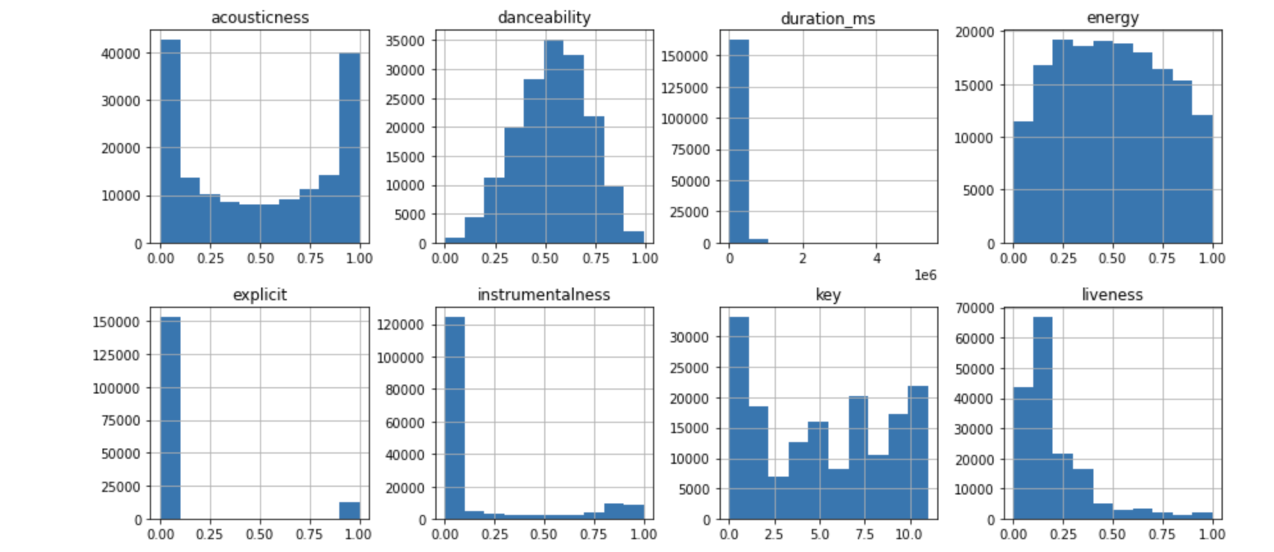
Exploratory Data Analysis

Slide 6
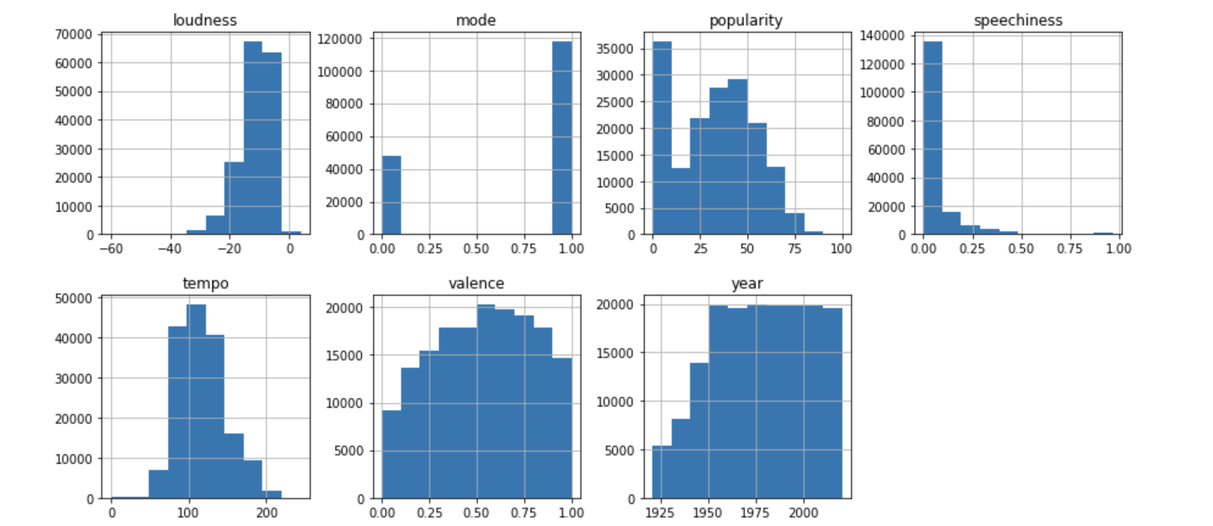

Slide 7
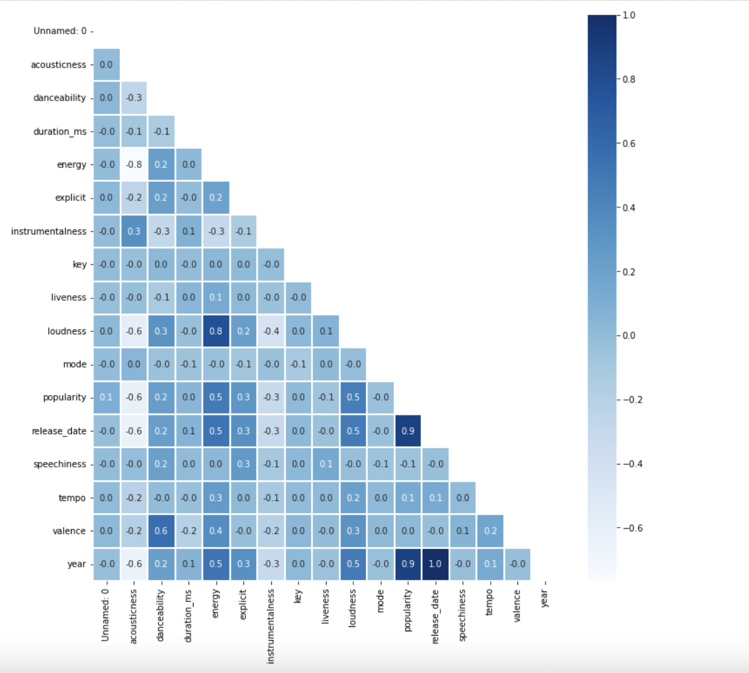
Correlation Heatmap
Takeaways -
1. danceability and valence have High Positive Correlation.
2. loudness and energy have High Positive Correlation.
3. accousticness has negative correlation with energy, loudness, popularity and year.
4. popularity is highly positively correlated with year.
5. loudness and energy have strong correlation with popularity.

Slide 8
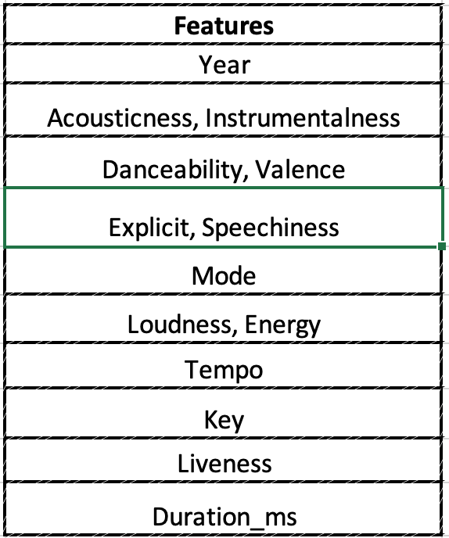
Feature Selection
Combining correlated features and select important features
{loudness, energy} -> {loudness}
{danceability, valence} -> {danceability}
{acousticness, instrumentalness} -> {acousticness}
{explicit, speechiness} -> {explicit}
Notes:
Feature selection on numerical variables - based on the corr matrix, found that these variables had strong correlation with each other,
Selected those considered more important

Slide 9
Data Pre-Processing
Remove duplicates
Remove entries with N.A or invalid data in any column
For some algorithms, ie. SVM, Logistic regression, KNN, we have done the Scaling
Categorize Popularity:
Non-popular < 50
Popular >= 50
Split data into train and validation dataset

Slide 10

Data Modeling
Popularity is our target variable. The popularity level of songs with wide appeal is distributed to large audiences in the music industry.
Our goal is to predict popularity based on a ​​songs’ attributes.
Our mission is to create a model which can predict popularity to the highest accuracy. We want to help music investors productionalize and enable a fulfilling end-user prediction experience with songs containing features as the popular ones.

Slide 11
Model: Linear Regression
1. Polynomial Regression
Best hyperparameter chosen: 5
Overall accuracy: 79% 2. Ridge
Best hyperparameter chosen: 10
Overall accuracy: 77%
3. Lasso
Best hyperparameter chosen: 0.0001
Overall accuracy: 77%

Slide 12
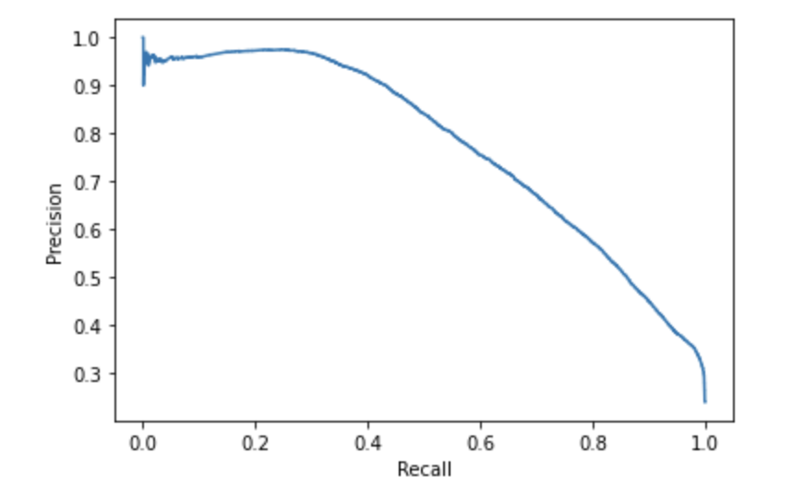
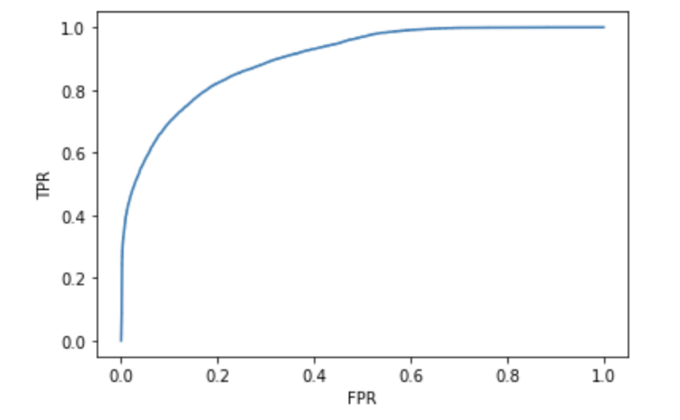
Model: Logistic Regression
Precision vs Recall
Fast to train and predict.
Best hyperparameter chosen: C = 0.01, Penalty = l2 (Ridge)
Accuracy score: 85.9%
Precision score: 70.7%
Recall score: 66.1%
F1 score: 68%
AUC for logistic regression: 0.90
ROC Curve

Slide 13
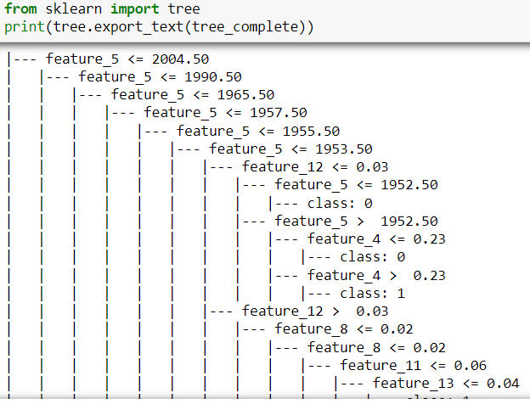
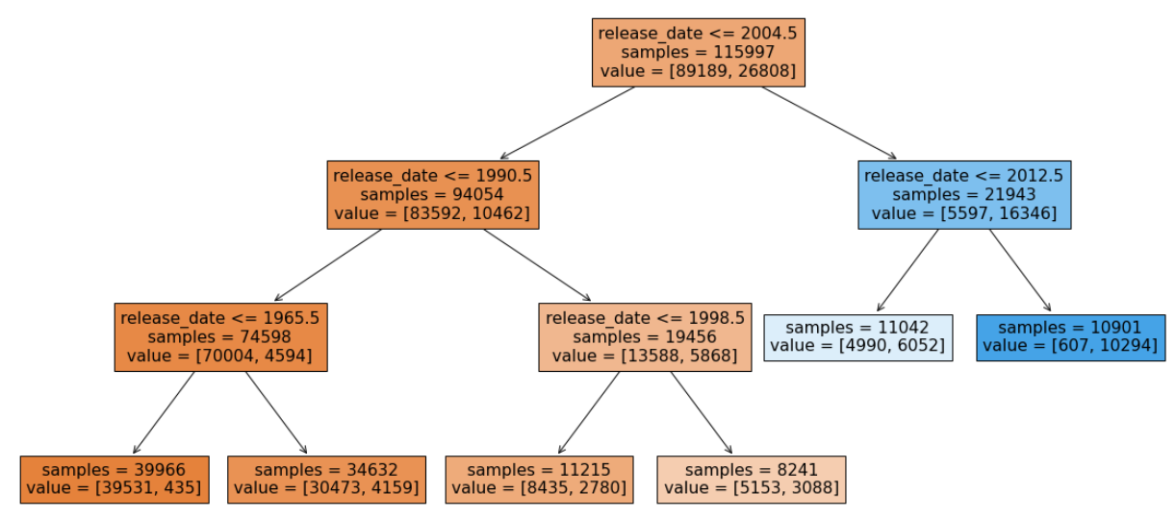
Model: Decision Tree
Tree without pruning (very large in size)
Decision tree model without pruning:
Test Accuracy score: 80.6%
Train Accuracy score: 99.7%
Overfitting issue
Large tree (difficult to visualize)
No scaling required
Model with Pre-Post pruning using GridSearchCV:
Addresses overfitting issue
Test Accuracy score: 86.5%
Train Accuracy score: 86.1%
Precision score: 74.5%
Recall score: 62.2%
F1 score: 67.8%
Small tree (easy to understand)
Tree with pruning

Slide 14
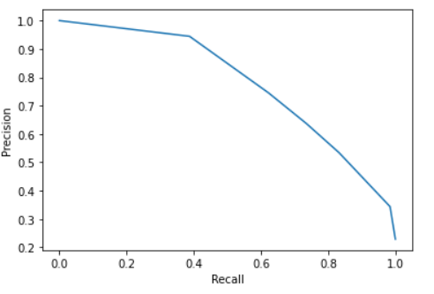
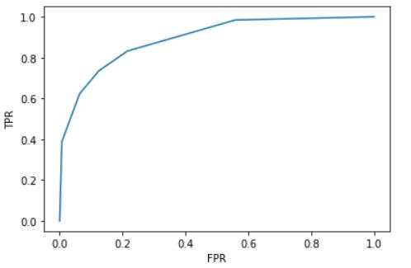
Model : Decision Tree
Precision vs Recall
ROC CURVE
AUC for decision tree: 0.9

Slide 15
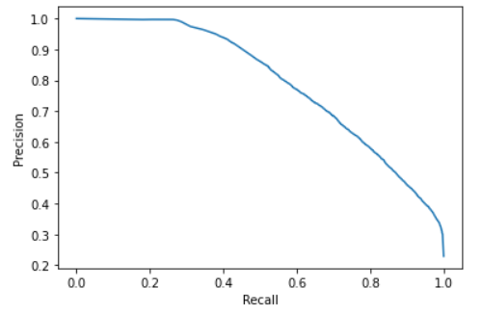
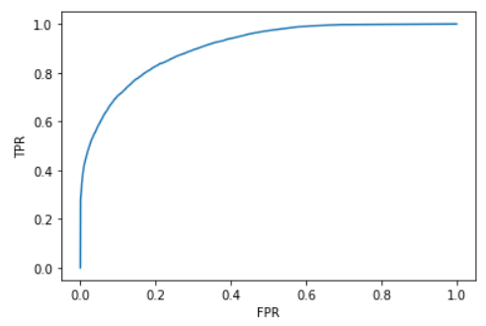
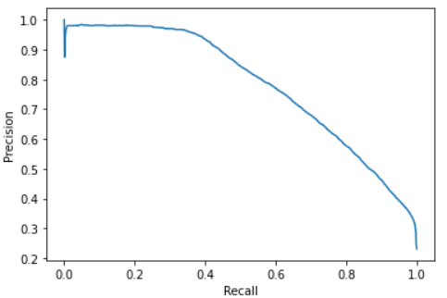
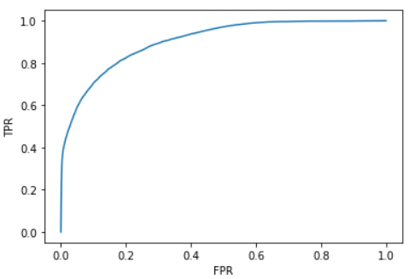
Decision Tree Ensemble Methods
Used GridSearchCV to arrive at best parameters for below models:
RandomForestClassifier
Computationally heavy to implement
Averages results of multiple random decision trees
Difficult to visualize
Accuracy score: 86.8%
Precision score: 78.8%
Recall score: 57.9%
F1 score: 66.7%
GradientBoostingClassifier
Faster than RandomForest as 1-5 trees are generally used
each new tree tries to correct mistakes of previous tree
Accuracy score: 86.7%
Precision score: 77.8% Recall score: 59.1%
F1 score: 67.1%

Slide 16
Linear SVM (Binary class)
Confusion matrix
 | P. Not Popular | P. Popular
A. Not Popular | 35137(70.6%) | 3194(6.4%)
A. Popular | 3884(8.8%) | 7499(15%)
Model with default hyperparameter:
Accuracy score: 85.7%
Precision score: 70.1%
Recall score: 65.8%
F1 score: 67.9%
Model with GridSearchCV:
Best Para: C = 0.01
Matrices values are the same as the model with default hyperparameter

Slide 17
Kernel SVM (Binary class)
Confusion matrix for default Kernel SVM
 | P. Not Popular | P. Popular
A. Not Popular | 12159 (73.3%) ↑ | 596 (3.5%) ↓
A. Popular | 1598 (9.6%) ↑ | 2219 (13.3%) ↓
Kernel SVM with default hyperparameter:
Accuracy score: 86.7%
Precision score: 78.8%
Recall score: 58.1%
F1 score: 66.9%
Hyperparameter tuning with the below parameter:
RBF: {'C': [1100, 1200, 1400 ] , 'gamma': [0.005, 0.01, 0.05]}
Poly: {'C': [10, 15, 20], 'degree': [2,3,4]}

Slide 18
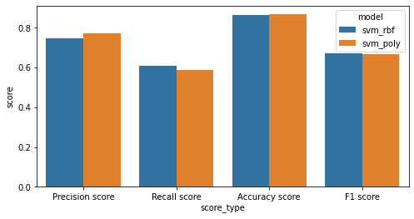
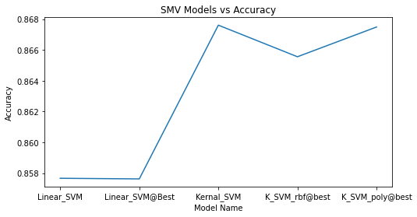
Kernel SVM (Binary class)
Confusion matrix for RBF SVM
 | P. Not Popular | P. Popular
A. Not Popular | 6030 (72.7%) ↓ | 384 (4.6%) ↑
P. Popular | 730 (8.8%) ↓ | 1142 (13.7%) ↑
Confusion matrix for Polynomial SVM
 | P. Not Popular | P. Popular
A. Not Popular | 6090 (73.4%) ↑ | 324 (3.9%) ↑
A. Popular | 774 (9.3%) ↓ | 1098 (13.2%) ↓

Slide 19
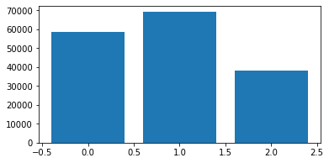
Kernel SVM (Multi-class)
Class 2 >= 50, Class 1 >= 25, Class >= 0
Linear SVM, with C = 0.5
Accuracy = 73.7%
Kernel SVM with RBF
'C': [50, 100, 1000]
'gamma': [0.001, 0.005,0.01]
Accuracy: 72.2%
Confusion matrix
 | P. 0 | P. 1 | P. 2
0 | 2544 (30%) | 390 (4.7%) | 11 (0.1%)
1 | 309 (3.7%) | 2790 (33%) | 370 (4.4%)
A. 2 | 33 (0.3%) | 686 (8.2%) | 1153 (14%)

Slide 20
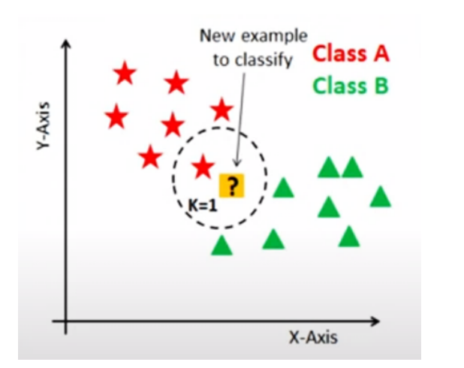
KNN
df['popularity_bi'] = [1 if x >= 50 else 0 for x in df['popularity']]
KNN score with n neighbors =3 : 81.02%
With KNN (K=1) train accuracy is: 99.76% With KNN (K=1) test accuracy is: 78.56%

Slide 21
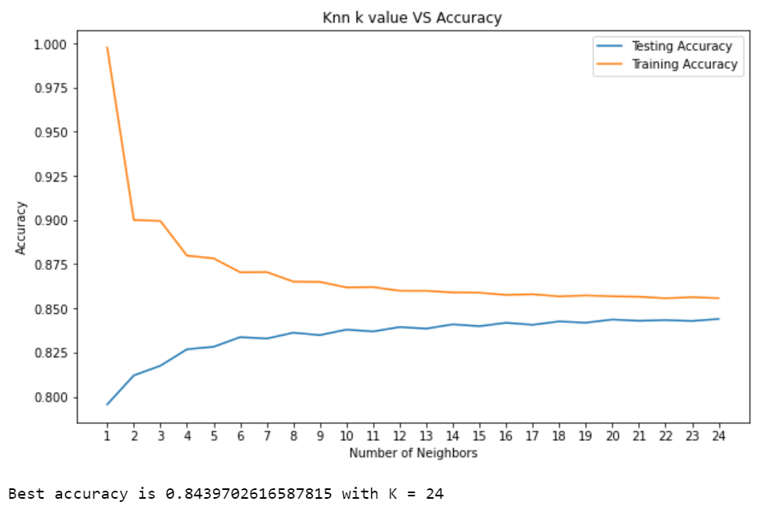
KNN k value vs Accuracy
Notes:
No Overfitting

Slide 22

KNeighbor Classifier with GridSearchCV
Best k is: {'n_neighbors': 25}
Mean validation score is: 83.65%
Test accuracy: 83.36%

Slide 23
KNN Confusion Matrix
Accuracy score: 83.36% Precision score: 81.53% Recall score: 76.36% F1 score: 78.86%
Confusion matrix
 | A. Pos | A. Neg
P. Pos | 21678 | 2912
P. Neg | 3979 | 12859

Slide 24
Model Performance Evaluation
Model | Sub-Category | Accuracy | Precision | Recall | F1 | Decision
Linear Regression | Polynomial Regression, with hyperparameter = 5 | 79% (RSquare)
Logistic Regression | L2 Regularization used | 85.9% | 70.7% | 66.1% | 68.3%
Decision Tree | Decision Tree with pruning gives better performance | 86.5% | 74.5% | 62.2% | 67.8%
SVM | Kennel Polynomial degree 3 | 86.7% | 77.2% | 58.6% | 66.6%
KNN | Knn with k=25 | 83.3% | 81.5% | 76.3% | 78.8%

Slide 25
Future Scope
Our next plan is to explore Neural Networks models (ANN, CNN) to find non-linear dependency with complex relationships between the features. The model keeps learning until it comes out with the best set of features to obtain a satisfying predictive performance.
We also hope to make use of audio files and lyrics to further improve our model performance in the near future.
With the advanced computational resources, we want to implement the computational costly model to come up with better models

